Slide 1
32 Core General Purpose GPU

Slide 2
Table of Contents
Objectives
Overall architecture
PL side
Datapath
Controller
ADV-7511
PS side
Architecure
Program Flow
Clock Domains
Challenges Faced
Results
Future Contributions and Conclusion
Performance Analysis

Slide 3
1 – Objectives
To design a general-purpose, programmable SIMD GPU architecture
To achieve 32x parallelism with 32-bit fixed point precision
To design a custom 32-bit ISA to control the GPU
To design AV (Audio, Video) pipeline capable of playing raw HD (1280x720) video at 25 FPS

Slide 4
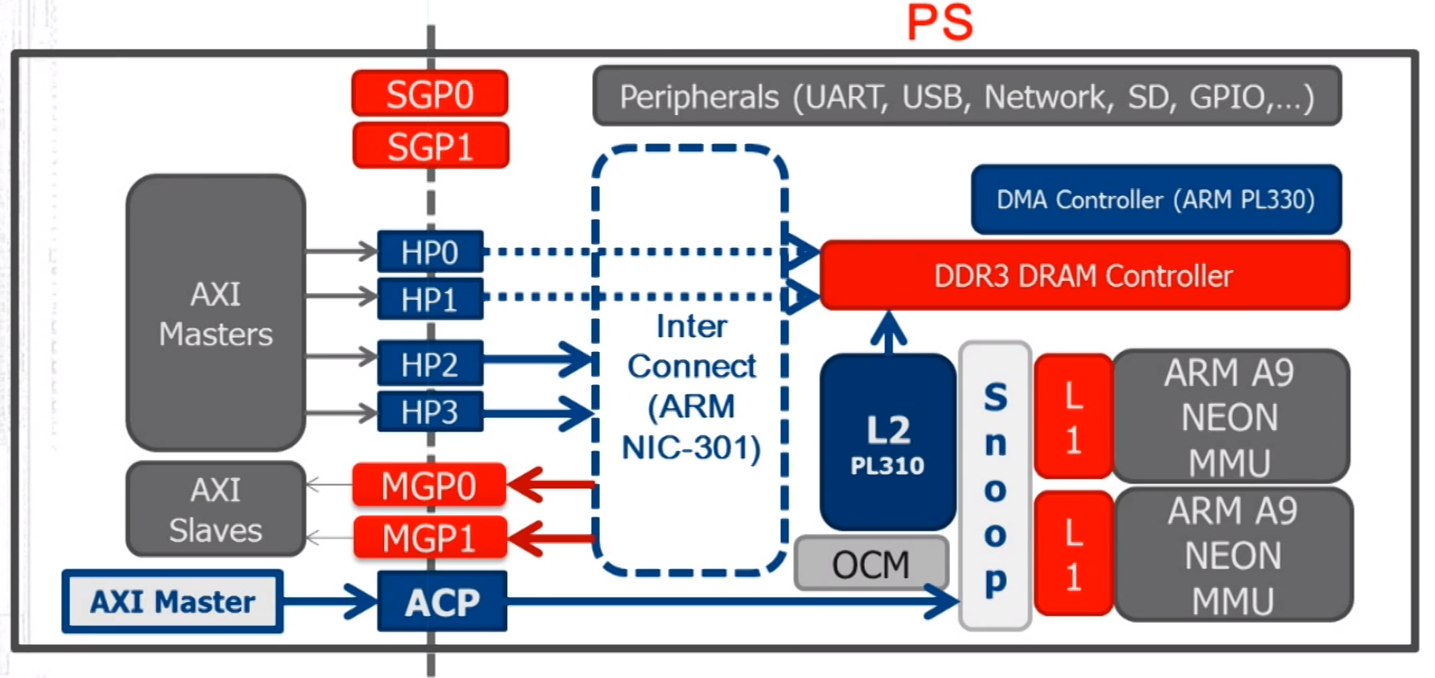
2.1 – Overall Architecture
Heterogenous computing based architecture
GP-GPU has been designed on the Programmable Logic part of the ZYNQ-SoC
ARM Cortex CPU and 1GB DDR3 RAM on processing system part have been utilized to make Audio-Video pipeline possible
Design has been implemented on ZC706 evaluation board
ZYNQ Architecture has been attached for reference:

Slide 5
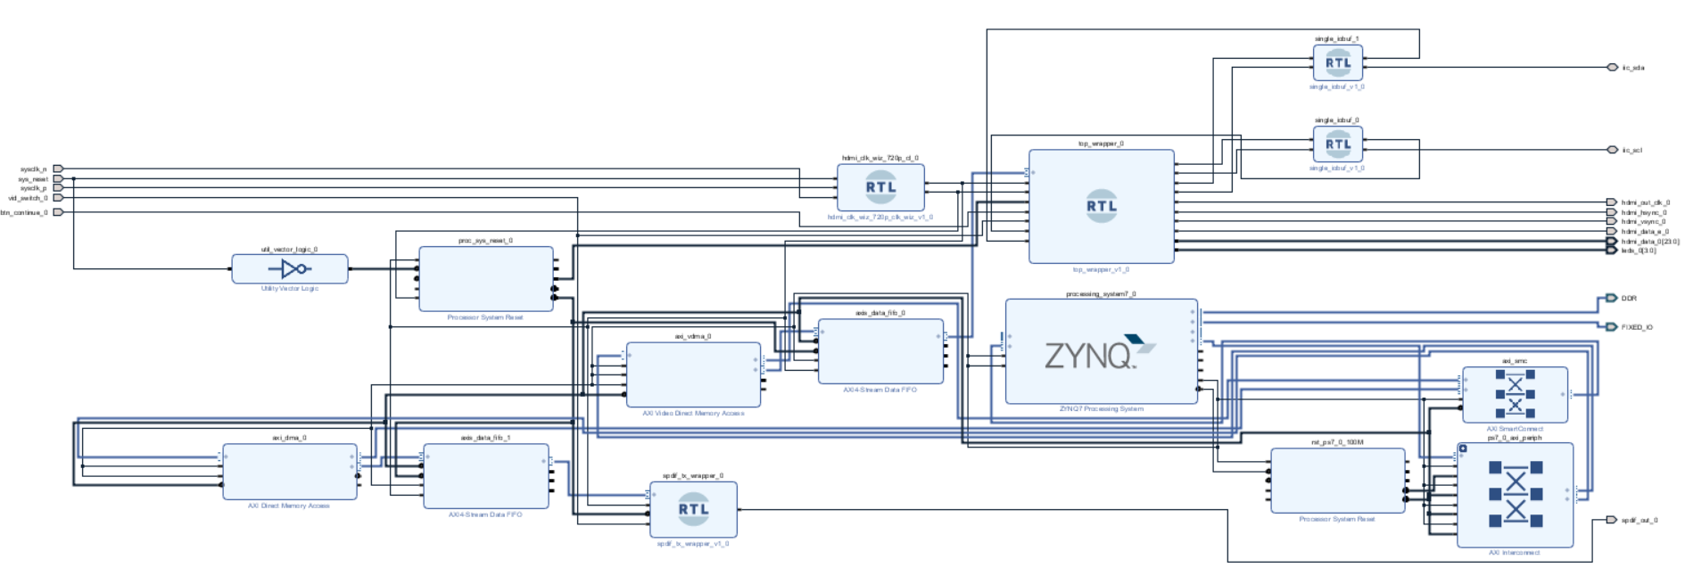
2.2 - Overall Architecture
Bird’s eye view of top block diagram
Role and Working of each subsystem have been explained in next few slides

Slide 6
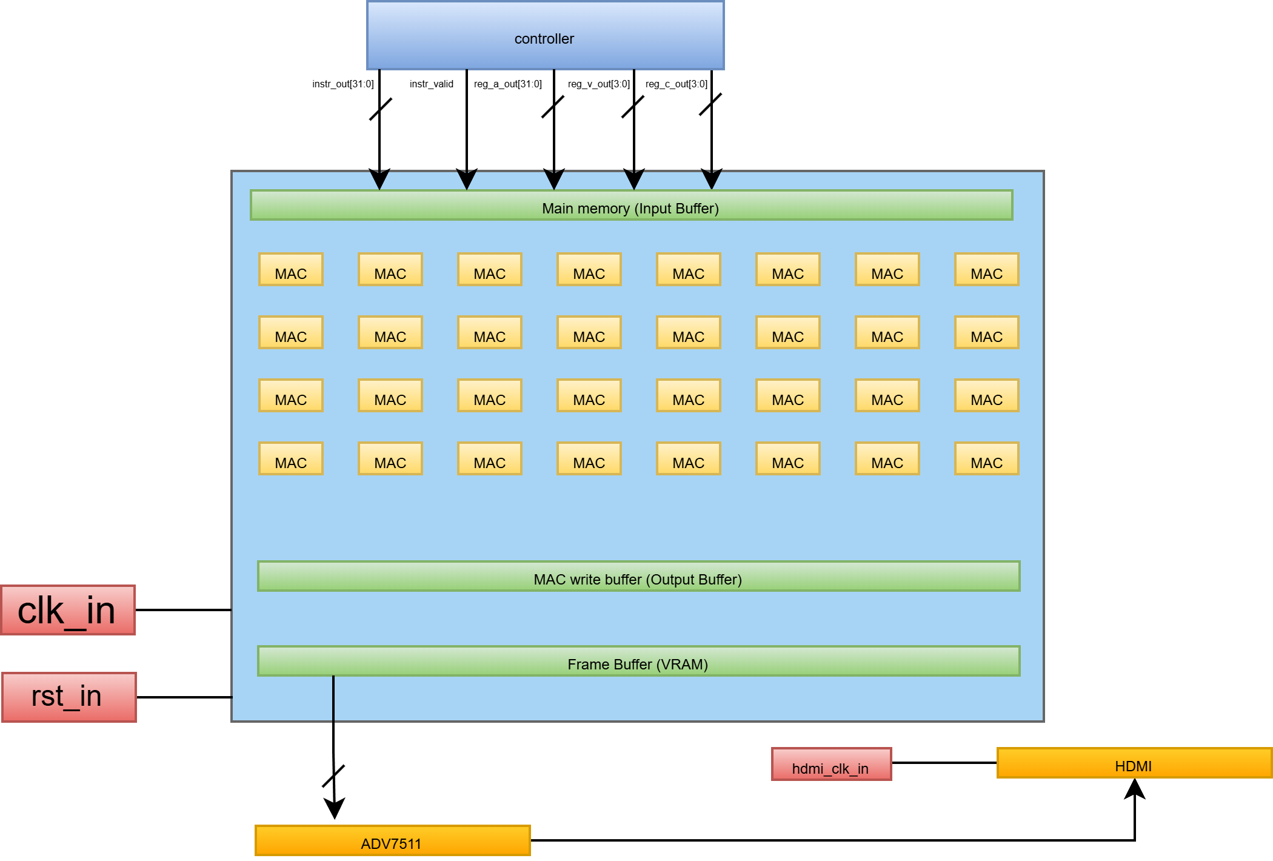
3.1 – Programmable Logic
Datapath design
Features 32 MAC modules capable of performing computations in 32-bit fixed point (Q8.24)
Each MAC unit has 3-32-bit inputs A, B, C and one output as (AxB)+C
Main memory works as an L1 cache to store results of intermediate variables
Main memory width: 32x32x3 = 3072 bits
MAC write buffer caches the outputs of all FMAs over 3 clock cycles (3072 bits)
Finally, pixel values to be displayed on screen are placed in VRAM (1.84 Mb)
ADV7511 chip on ZC706 has been utilized to send the HDMI signals

Slide 7
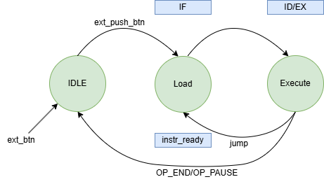
3.2 – Programmable Logic
Controller Design
Datapath agnostic controller
Acts as the Instruction Fetch/Decode unit, sending 32-bit instructions to the SIMD datapath
Has a register file with sixteen 32-bit general purpose registers to store loop counters and stride coeffecients
Instruction memory utilizes true dual port BRAM (32 bit x 100) to fetch the current instruction and prefetch next simultaneously
Handles SIMD branch divergence via predictive masking (OR instruction) to keep MACs in lockstep

Slide 8
3.3 – Programmable Logic
Memory Architecture
Features a 3072-bit internal data bus to route coordinates to all 32 MAC cores simultaneously
Main Memory: Synthesized from D-flip flops instead of BRAM to allow instantaneous 3072-bit RW access for intermediate 32-bit fixed point variables
MAC Write Buffer: A 32x32x3 = 3078 bit wide collector register that caches parallel MAC outputs over 3 clock cycles
VRAM (Frame Buffer): A 1.84 Mb Dual-Port BRAM allowing simultaneous GPU writing (Port A) and HDMI VTC reading (Port B)
Hardware Double Buffering: Screen tearing or rendering artifacts have been eliminated by flipping the MSB of VRAM, which changes the active HDMI display region

Slide 9
3.4 – Programmable Logic
ISA
4 bit op code I 4 bit reg I 16 bit immediate I 4 bit reg I 4 bit reg (Big Endian Style)
Category | Instructions | Core Hardware Function
Control Flow | NOP, END, PAUSE | FSM state control and hardware interrupt waiting.
Branching | BGE, JUMP | Conditional program jumping via internal compare flags.
Scalar ALU | XOR, ADD, ADDI | 32-bit scalar math utilizing the 16 Controller GPRs.
SIMD Load | LOADI, LOAD, LOADB | Spatial coordinate prep and scratchpad data shuffling.
SIMD Exec | WRITEB, WRITE | Commits data to L1 cache and triggers 32-wide MAC pipeline.
GPU Sync | FBSWAP, OR, SENDITERS | Divergence masking, VRAM flushing, and double-buffer toggling.

Slide 10
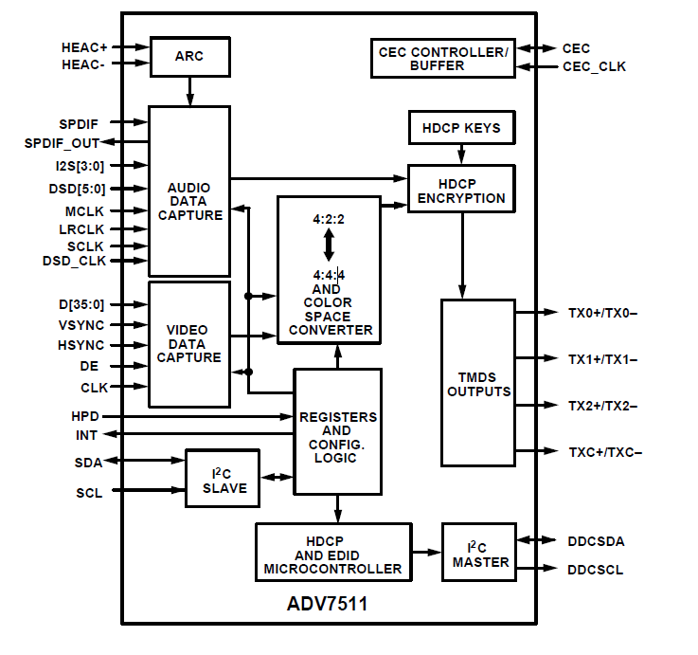
Driven by a dedicated PL-side hardware state machine (adv7511_init) to manage the I2C (IIC) configuration protocol
3.5 – Programmable Logic
ADV-7511
Driven by a hardware state machine to manage the I2C configuration protocol working on 100 kHz
Transmitter configured to accept 24 bit RGB 4:4:4 color space
Configures the ADV7511 SPDIF registers with a N-value of 6144 (0x1800) and enables Auto-CTS to lock the 48 kHz stereo PCM audio to the 74.25 MHz video clock.
Loads a 31-instruction transaction table configuring the chip for a 16:9 aspect ratio, 24-bit color depth, and injects AVI and Audio InfoFrames into the HDMI stream.

Slide 11
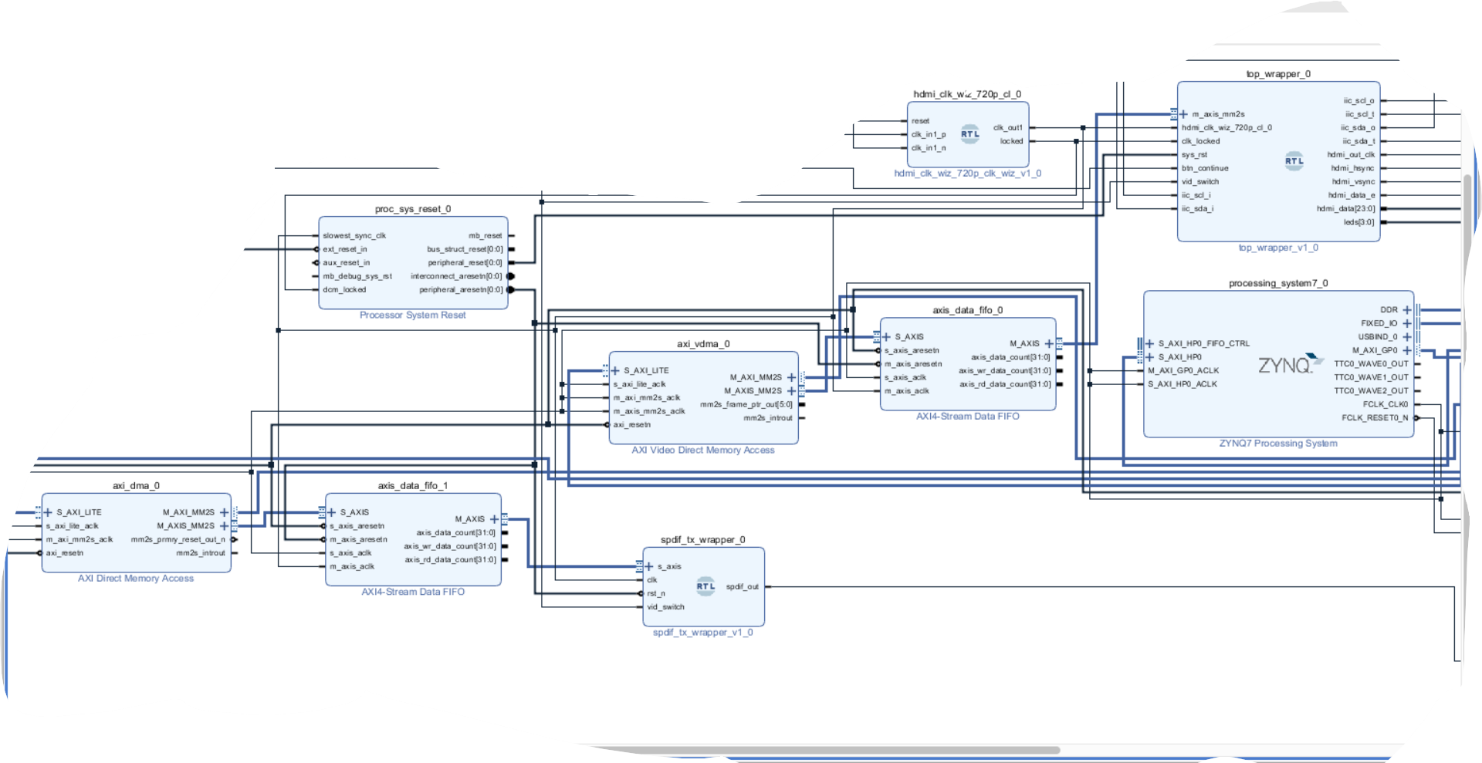
4.1 – Processing System
Functionality
Loads raw 1280x720 video from SD Card into DDR3 RAM using ARM Cortex CPU and then blasts the frames via the PL’s Video timing controller through AXI interfaces onto the screen
Loads raw 48 kHz stereo audio from SD Card into DDR3 RAM using ARM Cortex CPU and then sends the frames, through the AXI interfaces, to the SPDIF of ADV-7511
Architecture

Slide 12
4.2 – Processing System
Program Flow
System Initialization
AXI DMA Setup
Continuous Audio Streaming Loop
Continuous Video Streaming Loop
A/V Synchronization Management
Diagnostic

Slide 13
5.1 – Performance Analysis
Is able to render Mandelbrot set at 1280x720 resolution at about 0.7 FPS while simultaneously playing raw 1280x720 video in the background
More in demo

Slide 14
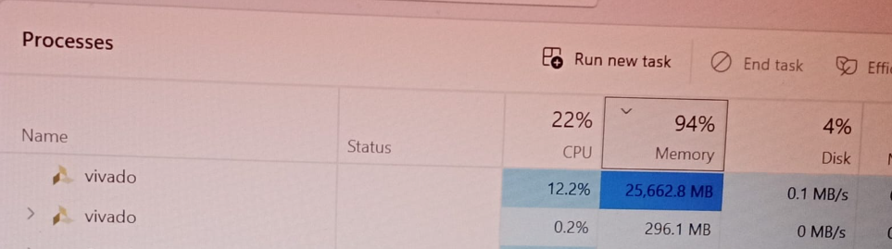
6.1 – Challenges

